Slide 1
Part 1: Python basic

Slide 2
CONTENTS
2
Part 1: Python basics
Getting Started with Jupyter Notebook
Variables and simple data types
Introducing lists, Tuples, Sets and Dictionaries
Conditional Statements and While loops
Function and class (OPP)

Slide 3
Conditional Statements
4.1. Conditional Statements
Conditional Tests
If Statements
Using if Statements with Lists

Slide 4
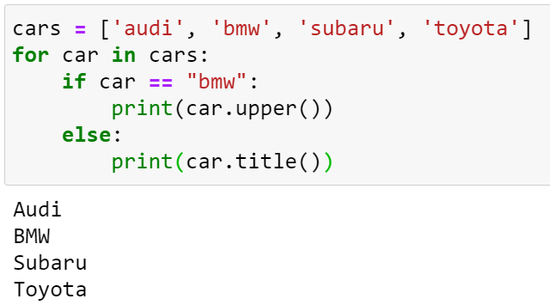
Conditional Tests
Conditional Statement

Slide 5
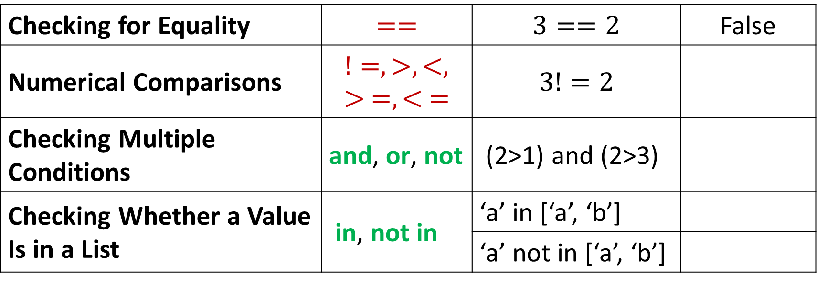
Conditional Tests
Checking for Equality | $$==$$ | $$3==2$$ | False
Numerical Comparisons | $$!=, >, <, > =,< =$$ | $$3!=2$$
Checking Multiple Conditions | and, or, not | (2>1) and (2>3)
Checking Whether a Value Is in a List | in, not in | ‘a’ in [‘a’, ‘b’]
 |  | ‘a’ not in [‘a’, ‘b’]

Slide 6
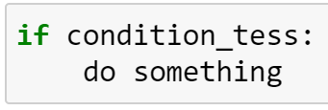
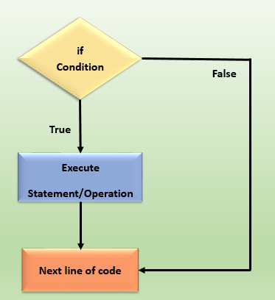
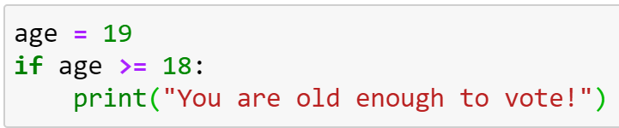

If Statements
Simple if Statements

Slide 7
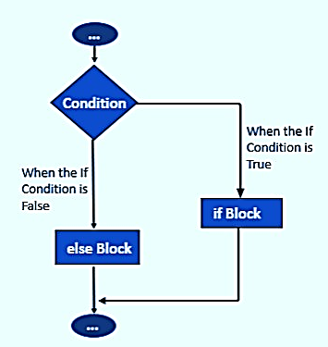
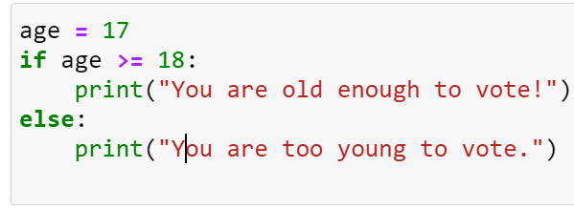

If Statements
if-else Statements

Slide 8
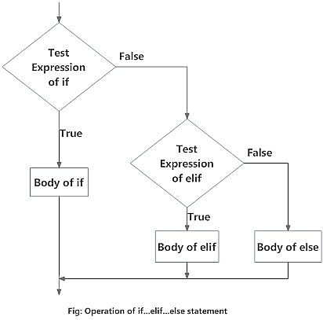
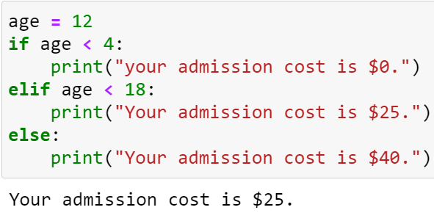
If Statements
The if – elif - else Chain

Slide 9
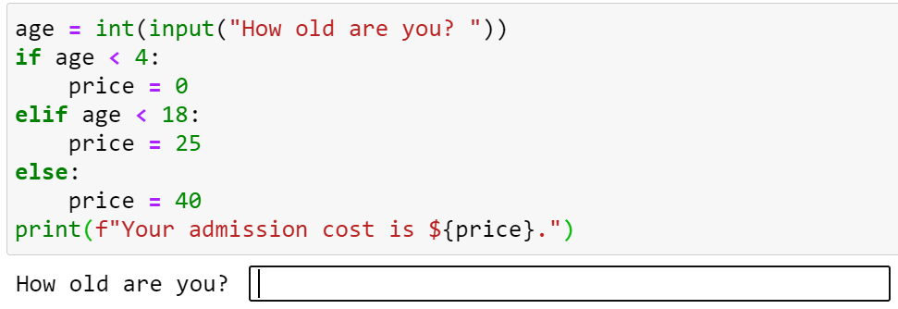
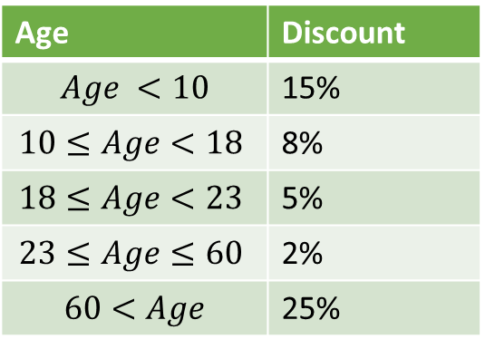
If Statements
Age | Discount
$$Age <10$$ | 15%
$$10≤Age<18$$ | 8%
$$18≤Age<23$$ | 5%
$$23≤Age≤60$$ | 2%
$$60<Age$$ | 25%
Male | Female
Gift | Gift
 | Gift
 | Gift
Gift | Gift

Slide 10
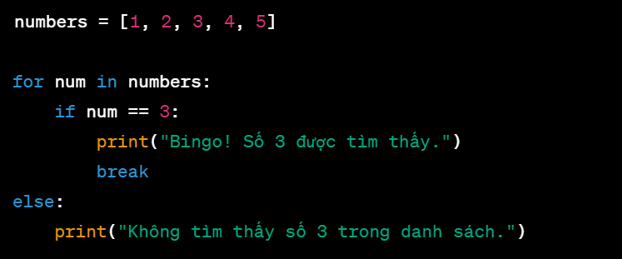
Practice
For … break… else

Slide 11
While loops
4.2. While loops
Introducing while Loops
Using a while Loop with Lists

Slide 12
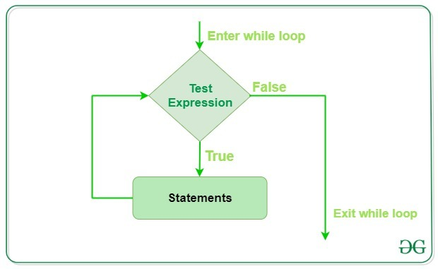
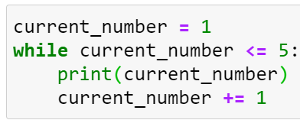
Introducing while Loops
For loop | While loop
The for loop takes a collection of items and executes a block of code once for each item in the collection | The while loop runs as long as, or while, a certain condition is true
The while Loop in Action

Slide 13
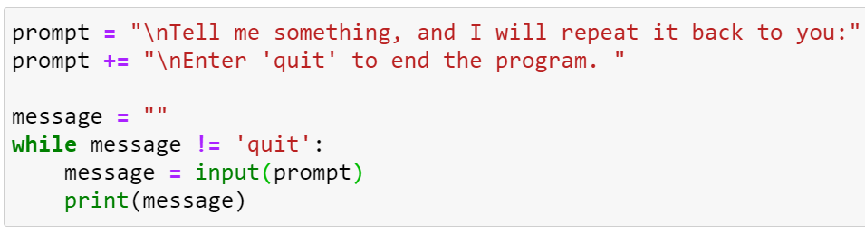
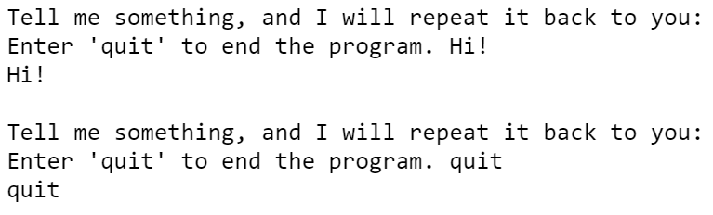
Introducing while Loops
Letting the User Choose When to Quit

Slide 14
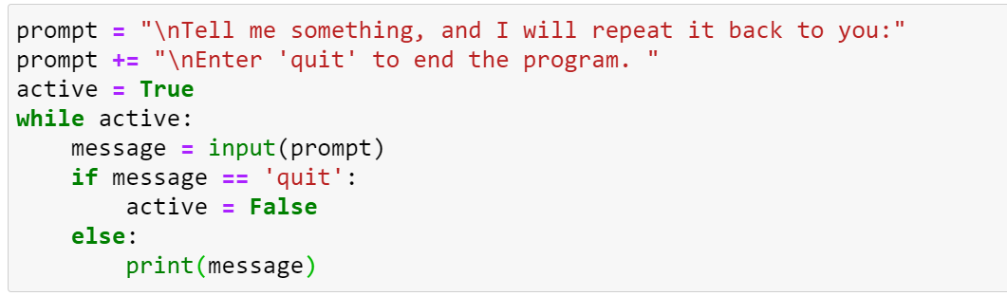
Introducing while Loops
Using a Flag

Slide 15
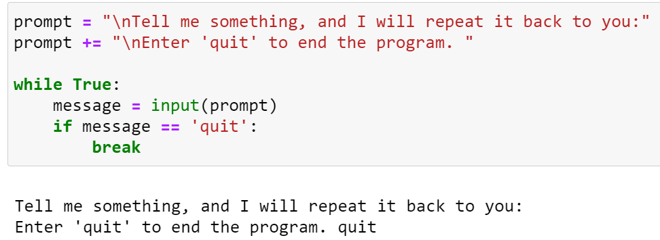
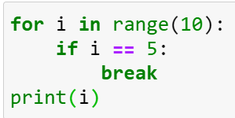
Introducing while Loops
Using break to Exit a Loop

Slide 16
Practice
Moving Items from One List to Another
Removing All Instances of Specific Values from a List

